Slide 1

Fellowship of the Heart
Getting Started — the Four Connects, walked around the table on alternating evenings
Evening Series 2026–27 · at the Tittle home · v1.5E DRAFT
All Scripture: ESV · The Companion lesson plans carry the full scripts — these slides carry the room
G1
Notes:
DECK TITLE · pre-session · DIVIDER
On screen as the room assembles on night one. All Scripture ESV; the plans carry the scripts; these slides carry the room — and these notes carry you.

Slide 2
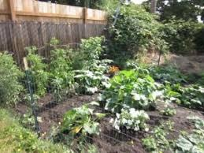
SESSION 9–10
The Garden of Your Heart — One Visit, the Returns Carry It
An experiential encounter with Jesus in your interior space — one guided run, teen-led; the week's returns are the second visit
Quarter 2: Connect with God
G2
Notes:
S9–10 COMBINED · pre-session · DIVIDER
On screen through dinner and as the circle forms. Greet at the door — the slide holds the room.

Slide 3




Where We Are — the Four Connects
Session 9–10 combined stands in the third box — Connect with God — one guided garden run, teen-led; the returns carry the second visit. Each connection makes the next one real (Matt. 22:37–40).
G3
Notes:
S9–10 COMBINED · WELCOME · LEAD: CONTAINER HOLDER · GROUNDING — every session opens on this map
BEATS:
1. Locate tonight on the map, plainly: Session 9–10 combined stands in the third box — Connect with God — one guided garden run, teen-led; the week's returns carry the second visit.
2. The four boxes are one journey — each connection makes the next one real — rooted in the two great commandments: love God, love neighbor (Matt 22:37–40).
3. This is also the 'where we are on the map' minute the welcome owes any newcomer.
CUES: Two minutes at most; then tonight's road.

Slide 4

Session 9–10 — Tonight’s Road
1 Welcome and centering
2 Week 7 check-in
3 Scripture and framing
4 Bridge into the exercise
5 The Garden exercise — whole room, then pairs
6 Merge and one-word landing
7 Homework commissioning — handout + check-in partners
8 The Leader Feedback Round — both leaders
9 Closing container
G4
Notes:
S9–10 COMBINED · 7:00–8:30 · LEAD: BOTH LEADERS
BEATS:
1. The garden's deepest work happens on repetition — in the two-session form the room came back a week later; in the combined form the three homework returns ARE the second visit, and next session's check-in receives them.
2. Shape: open, check-in, Scripture and framing (John 15; Psalm 23), bridge and settle, the guided run — a senior reads the walk-through, two words per second, the pauses are where the work happens; adults hold the sharing — journaling, pair sharing by invitation, merge, the returns commissioned, feedback, gentle close.
3. The current-condition form: teen-led from the first run. The separate second-running evening (Session 10) is held in reserve for a larger room of newer people.
GUARD: Settle Protocol stands — anything heavy in the garden: stop for them, not the circle; no return to the exercise today. The senior never takes a disclosure; the bright line governs.

Slide 5
Opening Container — the Eight Steps
1 Welcome — five minutes to open the container
2 Phones silenced and put away
3 Stand in a circle
4 One-word check-in — how you actually are, right now
5 Put out / bring in — set something down; bring a blessing in
6 Spoken commitment: “I am here. I am paying attention. I am willing to be moved.”
7 Opening prayer — “Holy Spirit, you are welcome here. Speak. We are listening.”
8 Sit. Begin.
G5
Notes:
S9 · 7:00–7:08 · LEAD: CONTAINER HOLDER
BEATS: 1. 'Welcome back. Find a seat.' Wait — take a longer breath than usual before the blessing. 2. Aaronic blessing. 3. Frame: today is quiet, mostly interior; deeply familiar for some, brand new for others — both are fine. 4. Container: what is said here stays here; nothing is required; listen to receive.
PAIR LEAD: name the leading pair in the welcome — two leaders hold tonight, and the room will see the evening handed back and forth between them; that is the design. The pair practices the session together beforehand.

Slide 6

Week 7 Check-In
• “Last week we walked PROAPT — a six-step practice for hearing God in scripture.”
• “One sentence about how that practice has been?”
• A parent starts — arranged beforehand, never a cold call on a teen
• Two or three voluntary contributions; anyone may pass — kept brief, tonight’s arc needs the time
G6
Notes:
S9 · 7:08–7:25 · LEAD: CONTAINER HOLDER
BEATS: 1. One sentence each on how the daily PROAPT practice has been. 2. Take 2–3 voluntary contributions and keep it brief — today's arc needs the time later.
CUES: Arranged parent opens (check the Run Card) — never cold-call a teen; pass-anytime holds.

Slide 7
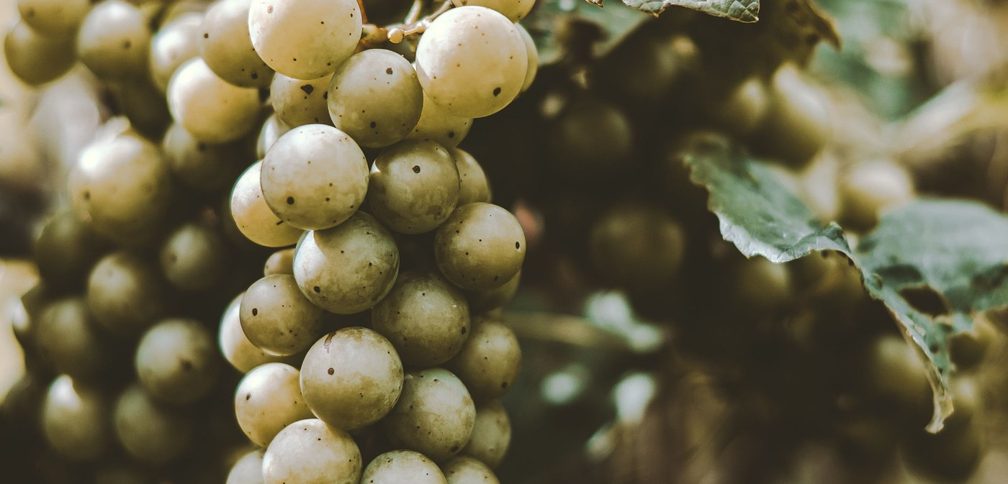
Scripture and Framing
• Two passages, read slowly — Psalm 23 and John 15:1–11 — “Listen as if you have not heard it.”
• Scripture pictures the heart as cultivated ground — green pastures, still waters, vine and vinedresser
• Tonight we walk into that image: picture your heart as a garden, invite Jesus in, notice what He does
• Imaginative prayer — Ignatius taught it, Bonaventure taught it, the Puritan writers under other names
• Not visualization-as-self-help, not contemplative emptying — filling the mind with one scriptural image
• “The exercise is not a test of imaginative power. It is a posture of receptivity.”
JOHN 15:5
“I am the vine; you are the branches. Whoever abides in me and I in him, he it is that bears much fruit, for apart from me you can do nothing.”
G7
Notes:
S9 · 7:25–7:40 · LEAD: CONTENT PRESENTER
BEATS: 1. Read Psalm 23 and John 15:1–11 slowly — 'listen as if you have not heard it.' 2. Teach: scripture pictures the heart as cultivated ground; today we walk into that image and invite Jesus in to walk it with us. 3. Name the lineage — imaginative prayer: Ignatius, Bonaventure, the Puritans — and the two nots: not visualization-as-self-help, not emptying the mind. 4. 'Vivid experience or nothing at all — both fine. The turning toward Him is the practice.' 5. If you sense resistance, read the skepticism paragraph — the frame IS the work; do not skip it.

Slide 8
Bridge into the Exercise
• We stay right here, together, as one room — a guided imaginative prayer, twelve to fifteen minutes, read slowly
• Eyes closed or open — either is fine; your own family is beside you the whole time
• Then five minutes with your journal, then pairs for sharing — by invitation only
• A parent will open each round — “Silence is a complete answer.”
• “Father, you are the vinedresser. … Where it is hard, be tender. Where it is closed, be patient. Where it is opening, be present.”
G8
Notes:
S9 · 7:40–7:42 · LEAD: CONTENT PRESENTER · TRANSITION
BEATS: 1. Preview the shape: guided prayer 12–15 min, whole room, eyes open or closed, your own family beside you; then 5 min silent journaling; then pairs for sharing by invitation only — silence is a complete answer. 2. Room about ten or fewer: name it now — sharing happens right in this circle, no moving. 3. Pray the bridge prayer: where it is hard, be tender; where it is closed, be patient; where it is opening, be present.

Slide 9
The Garden Exercise — Whole Room, then pairs
1 Settle (2 min) — “Take a breath. Settle. Eyes open or closed. Whatever feels honest. We have time.”
2 Guided prayer (12–15 min) — a senior reads, two words per second; the pauses are not optional — they are where the work happens
3 Silent journaling (5 min) — “Write in your Week 9 journal page what you noticed. Whatever you noticed.”
4 Sharing in pairs (8–10 min) — by invitation only; a parent opens; silence is a complete answer
• Receive without interpreting — “Thank you for sharing that.” Never “God was telling you _____.”
• If something painful surfaces — bless it: “I hear that. May Jesus stay with you in that place this week.”
G9
Notes:
S9 · 7:42–8:14 · LEAD: CONTENT PRESENTER
BEATS: 1. Settle 2 min. Guided prayer 12–15 min: read H9.1 slowly — two words per second, not three; every (pause) is a full 30 seconds, every (longer pause) 60. The pauses are where the work happens. 2. Silent journaling 5 min. 3. Then pairs for sharing by invitation, 8–10 min: the Companion models two plain sentences first, the arranged parent opens — receive without interpreting; never 'God was telling you...'.
CUES: Soft tears — do not stop; the tears are often the work. Never cold-call a teen; pass-anytime holds.
GUARD: If overwhelm goes past quiet reassurance, run the Settle Protocol — stop for THEM, not for the circle: plain directive words, back to the room, breathe and anchor, no return to the exercise today; nobody leaves activated.
COMBINED FORM: a Companion-in-Formation reads the walk-through from H10.1's pacing — two words per second, (pause) = 30 full seconds, (longer pause) = 60; the adults hold the sharing and anything that surfaces. The bright line governs throughout.

Slide 10
Merge and One-Word Landing
• “What happened in your pair stays in your pair.”
• One word about tonight — not what was said, but what you noticed
– “Surprised.” “Tender.” “Empty.” “Found.” “Confused.” “Quiet.”
• A parent begins; anyone may pass — each word received without commentary
• “Whatever happened tonight is yours. Some of it will keep happening across the week.”
G10
Notes:
S9 · 8:14–8:20 · LEAD: CONTENT PRESENTER
BEATS: 1. The room will be quieter than usual — honor it; wait before speaking. 2. What happened in the pairs stays there; ask only one word about today — 'surprised', 'tender', 'empty', 'found', 'quiet'. 3. Receive each word with eye contact and a slight nod; say nothing else. 4. Close: whatever happened today is yours; some of it will quietly do its work for a long time.
CUES: Arranged parent begins; anyone may pass.

Slide 11

Homework — Two Weeks, Four Parts
• Three returns this week — the returns ARE the second visit: most of us only get all the way in on a return
• “You don’t need the full guided script — you have the place now. Just go back.”
• Notice what is the same and what has changed — notice if Jesus is in a different place than He was tonight
• Pick three days and a time — morning before the day starts is often best
• If something heavy surfaces — stop, open your eyes, come back another day; tell a trusted adult
• Came in skeptical? The Note for the Skeptic handout is for you — adapting or sitting out for now is okay
G11
Notes:
S9 · 8:20–8:24 · LEAD: CONTENT PRESENTER
BEATS: 1. Co-Companion (Parent) leads. Three brief returns to the garden this week, 5–10 min each — no script needed, you have the place now; journal each visit (H9.2). 2. Gentle warning: a return can surface something heavy — you can stop, open your eyes, come back another day; and tell a trusted adult. You are not meant to carry the heavy things alone. 3. For the uneasy: H9.3, the Note for the Skeptic — adapting the practice or sitting it out is honored.
COMBINED FORM: say it plainly — the second guided evening lives in the returns now. Five to ten minutes each, journaled; no junior varsity garden: Jesus meets each person in the garden they actually have. Next session's check-in receives the returns.

Slide 12
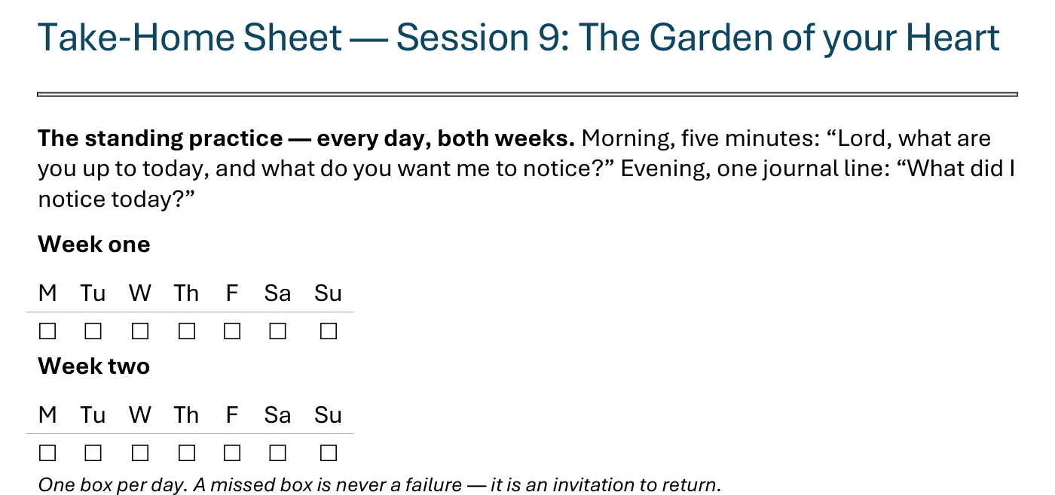
The Take-Home Sheet — the Daily Rhythm
Handed out now — this is the sheet in your hands.
G12
Notes:
S9 · COMMISSIONING · LEAD: CONTENT PRESENTER
BEATS:
1. The sheet on the screen is the sheet in their hands — walk it, don't read it.
2. The standing rhythm first: the morning question, the evening journal line — one box per day on the week-grids.
3. A missed box is never a failure — it is an invitation to return.
CUES: The four parts are the next slide.

Slide 13
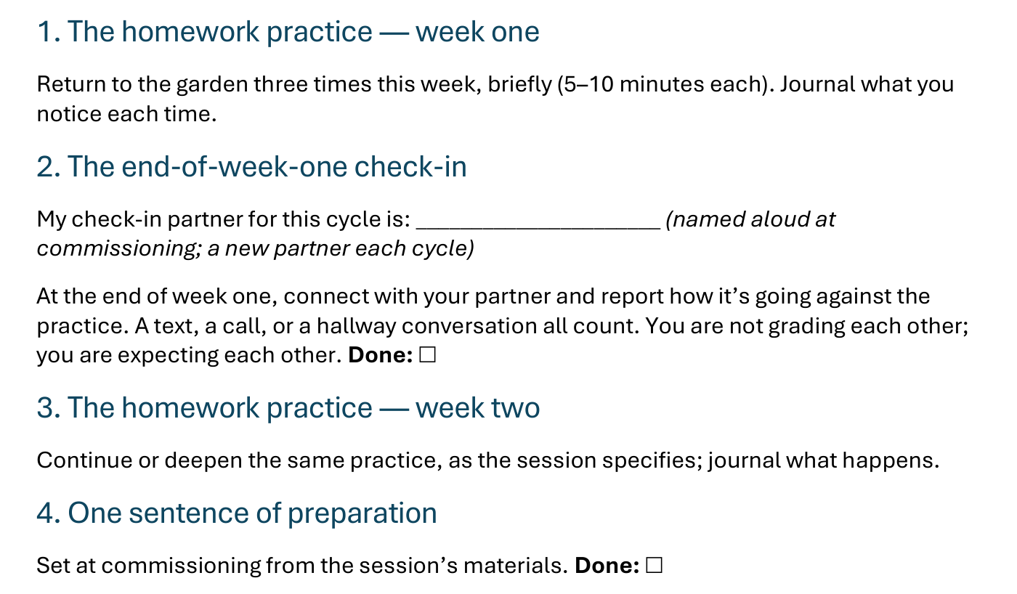
The Take-Home Sheet — the Four Parts
One practice at a time — and a partner expecting you at the end of week one.
G13
Notes:
S9 · COMMISSIONING · LEAD: CONTENT PRESENTER
BEATS:
1. The four parts, in order: the homework practice, week one; the end-of-week-one check-in; the homework practice, week two; one sentence of preparation.
2. Check-in partners are named aloud before leaving this slide — the sheet has the line to write the name.
GUARD: The sheet-walk, not a re-teach.

Slide 14

The Leader Feedback Round
• Two rounds, same as every session — the container holder first, then the content presenter: three things each
– “What I think went well tonight: ______”
– “What I’d do differently next time: ______”
– “If I were to teach tonight’s process to someone, I would tell them: ______”
• Then the room — the same two questions about tonight
• The leaders receive without defending — “thank you” is the whole response
G14
Notes:
S9 · 8:24–8:28 · LEAD: BOTH LEADERS
BEATS: 1. Same round: leader's three answers first, then the room's two questions; 'thank you' is the whole response. 2. Today is the likeliest night of the series to DROP the round: if the room is still deep in the garden's quiet, five minutes of process talk can break what the Spirit is holding. Drop it, and say so at the debrief.

Slide 15
Closing the Container + Aaronic Blessing
• We close the way we opened — the container, six steps:
1 Stand again — same circle, same posture as the open
2 One-word landing — compare it to your opening word
3 The one thing you are taking from tonight
4 The one practice — committed aloud, or modified to one you will actually keep
5 Blessings — eyes on the person, not the screen: say what is on your heart for them. Specific, witnessed, short
6 Closing prayer — and the Aaronic blessing, spoken over each other, face to face
THE AARONIC BLESSING — NUMBERS 6:24–26
“The Lord bless you and keep you;
the Lord make his face to shine upon you, and be gracious to you;
the Lord lift up his countenance upon you, and give you peace.”
G15
Notes:
S9 · 8:28–8:30 · LEAD: CONTAINER HOLDER
BEATS: 1. 'What happened in your pair is yours. Carry it gently — don't debrief it on the way home unless your heart is fully ready.' 2. If something heavy surfaced, reach out — the team is walking with you. 3. Aaronic blessing; see you evenings.
CUES: Stay accessible for fifteen minutes after the close — today more than most, people will want to talk; the two-adult rule holds for any teen.
BLESSINGS: eyes on the person, not the screen — nothing to read; say what is on your heart for them, specific and short.

